Slide 1

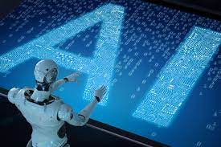
RAMEEZA FATIMA ( 5744 )
SEMESTER # 7TH
DEP# BIOTECHNOLOGY &BIOINFORMATICS
GOVERNMENT COLLAGE UNIVERSITY FSD

Slide 2
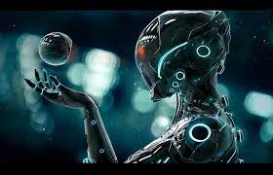
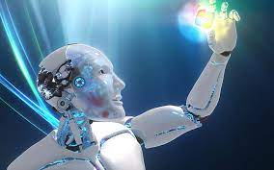
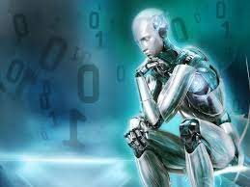
ROBOTICS:-

Slide 3
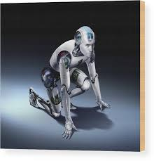
Contents:-
Robotics
Robotics
History
Robotics
Technology
Types of Robote

Slide 4
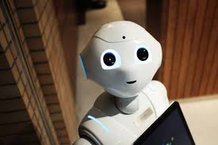
What is Robot..?
A re-programmable, multifunctional ,automatics industrial machine designed to replace human in hazardous work.
It can be used as :-
-An automatic machine sweeper.
-An automatic car for a child to play with.
-A machine removing mines in a war field in space.
-In military, and many more..

Slide 5
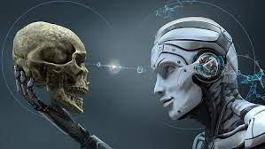
WHAT IS ROBOTICS..?
Robotics is science of designing or building an application of robots. Simply, Robotics may be defines as “The study of Robots”.
The aim of robotics is to design an efficient robot.
WHY IS ROBOTICS NEEDED..?
Robotics is needed because:-
Speed.
Can work in hazardous/dangerous temperature.
Can do repetitive tasks.
Can do work with accuracy.

Slide 6
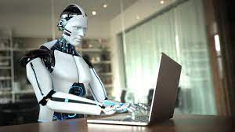
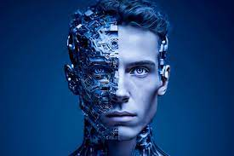
ROBOTICS HISTORY
First use of the word “Robotics”
Three Laws of “Robotics”
The first Robot “Ultimate”

Slide 7
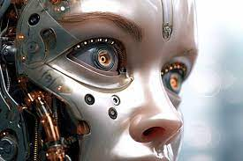
The Three Laws of Robotics:-
Asimov also proposed his three “Laws of Robotics”,and he later added a “zeroth law.”
Zeroth Law : A robot may not injure humanity,or through inaction,allow humanity to come to harm.
First Law : A robot may not injure humanity,or through inaction,allow humanity to come to harm,unless this would violate a higher order law.
Third Law : A robot must protect its own existence as long as such protection does not conflict with ahigher order law.
Notes:
kkkkkkkkkkkkkkkkkkko

Slide 8
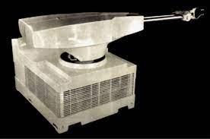
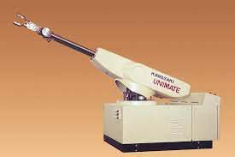
The First Robot “UNIMATE”

Slide 9
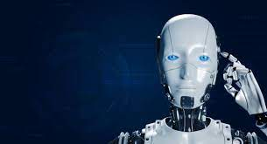
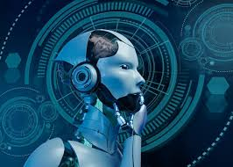
ROBOTICS TECHNOLOGY
Most Industrail robots have at least the following five parts:
Sensors
Effectors
Actuators
Controllers
Arms

Slide 10
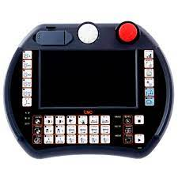
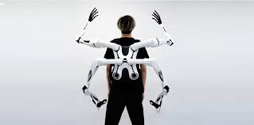
Touch screen Robot controller

Slide 11
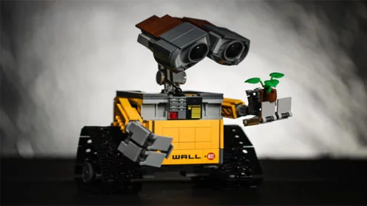
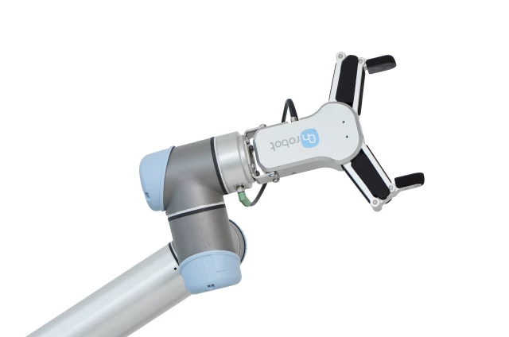
Sensor / Effector.

Slide 12
TYPES OF ROBOTS
The most common types of Robots are
Mobile Robots.
Stationary Robots.
Autonomous Robots.
Remote-Controlled Robots.
Virtual Robots.

Slide 13
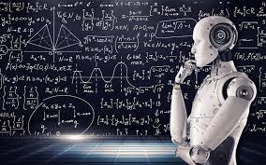
APPLICATIONS :-
Some of the most notable applications of robotics include:
Manufacturing: Robotics is widely used in manufacturing to automate repetitive tasks, increase productivity and improve quality.
Robots are used in assembly lines, welding, painting, and other manufacturing processes. In material handling industries where finished products are prepared for distribution, robotics are used for picking, sorting, packaging and palletizing of products.
Other industries that commonly use robotics include clinical laboratories, agriculture and education.

Slide 14
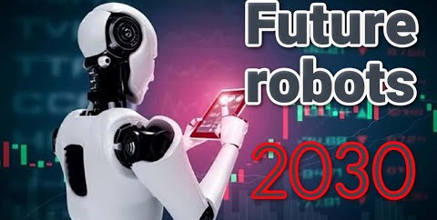
I visualize a time when we will be to robots what dogs are to humans, and I'm rooting for the machines.

Slide 15
REFERENCES:-
https://www.brainyquote.com/topics/robots-quotes.
https://www.slideshare.net/vundavallishreya/robotics-project-ppt.
https://www.motoman.com/en-us/applications.

